Slide 1
LOGIN SCREENS
Computing – Faculty of Business, Law and Digital
martin.reid@solent.ac.uk

Slide 2
On boarding
Sign up
login
Sign in

Slide 3
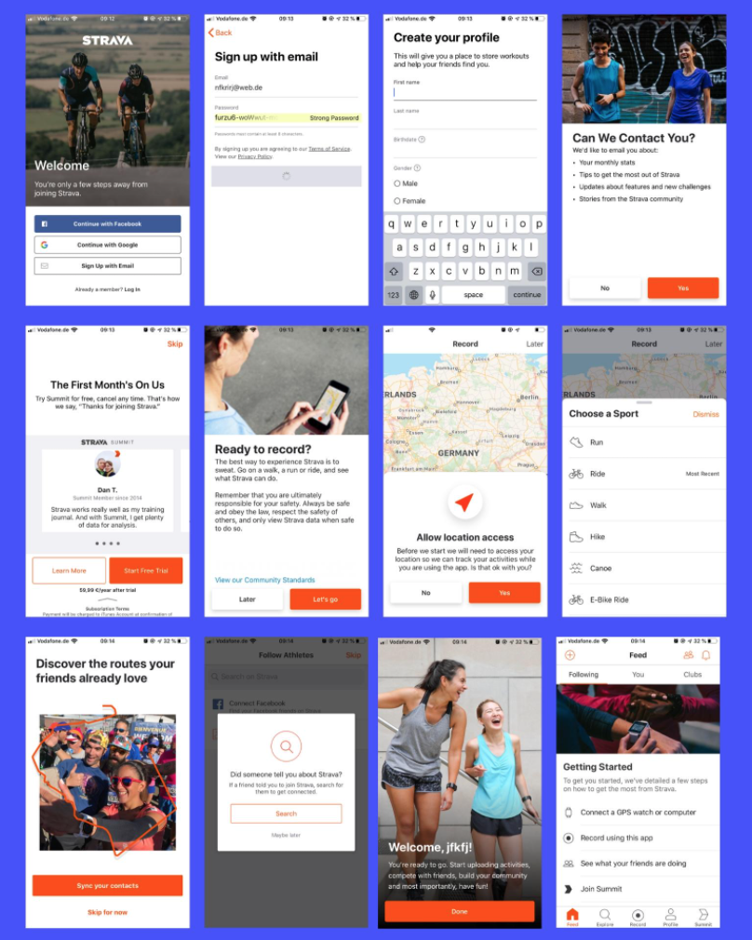
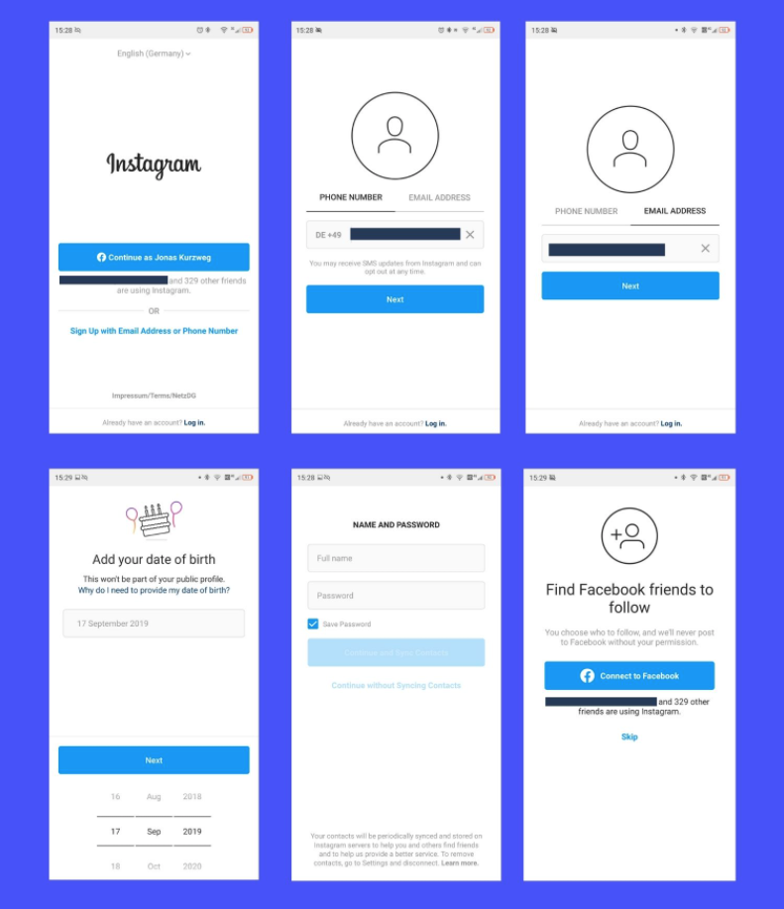
UXCAM., 2020. 10 Apps with the Best User Onboarding Flows 2020 | UXCam [viewed 25 October 2020]. Available from: https://uxcam.com/blog/10-apps-with-great-user-onboarding/

Slide 4
“The Heuristic technique, is any approach to problem-solving that uses a practical method or various shortcuts in order to produce solutions that may not be optimal but are sufficient given a limited timeframe or deadline”
INVESTOPEDIA., 2021. Heuristics [viewed 20 October 2021]. Available from: https://www.investopedia.com/terms/h/heuristics.asp
‌

Slide 5

THE ANIEROBI, 2021. Usability heuristics for cognitive disabilities. - UX Planet [viewed 20 October 2021]. Available from: https://uxplanet.org/usability-heuristics-for-cognitive-disabilities-6988266e42e8

Slide 6
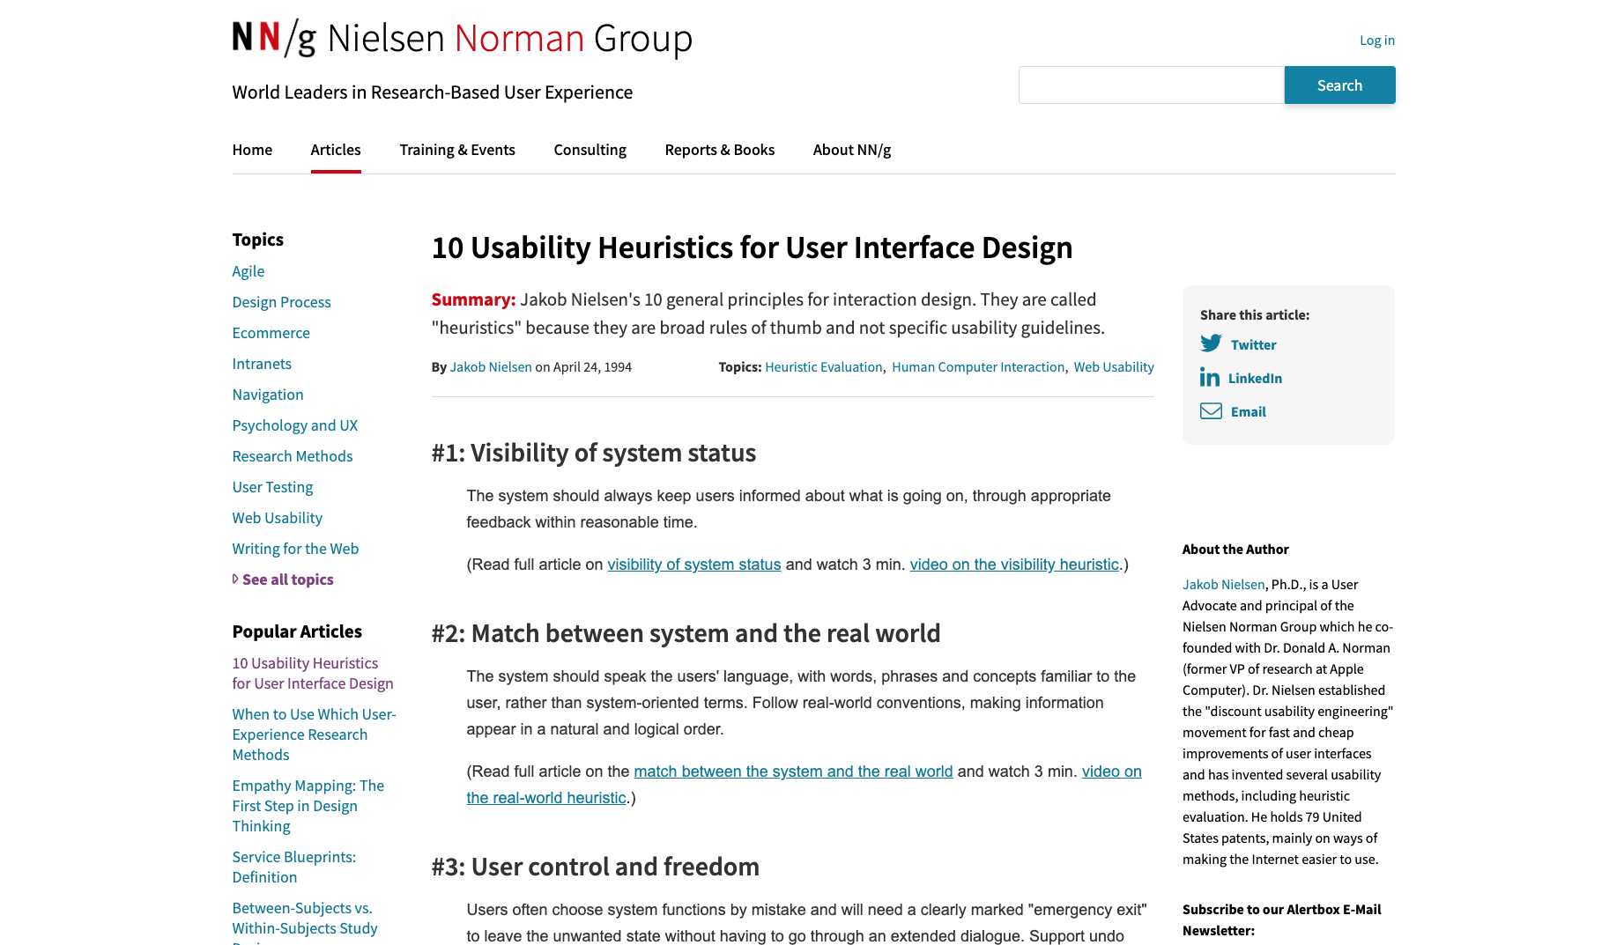
Nielsen., J. 2019. 10 Heuristics for User Interface Design: Article by Jakob Nielsen [viewed 25 October 2020]. Available from: https://www.nngroup.com/articles/ten-usability-heuristics/

Slide 7
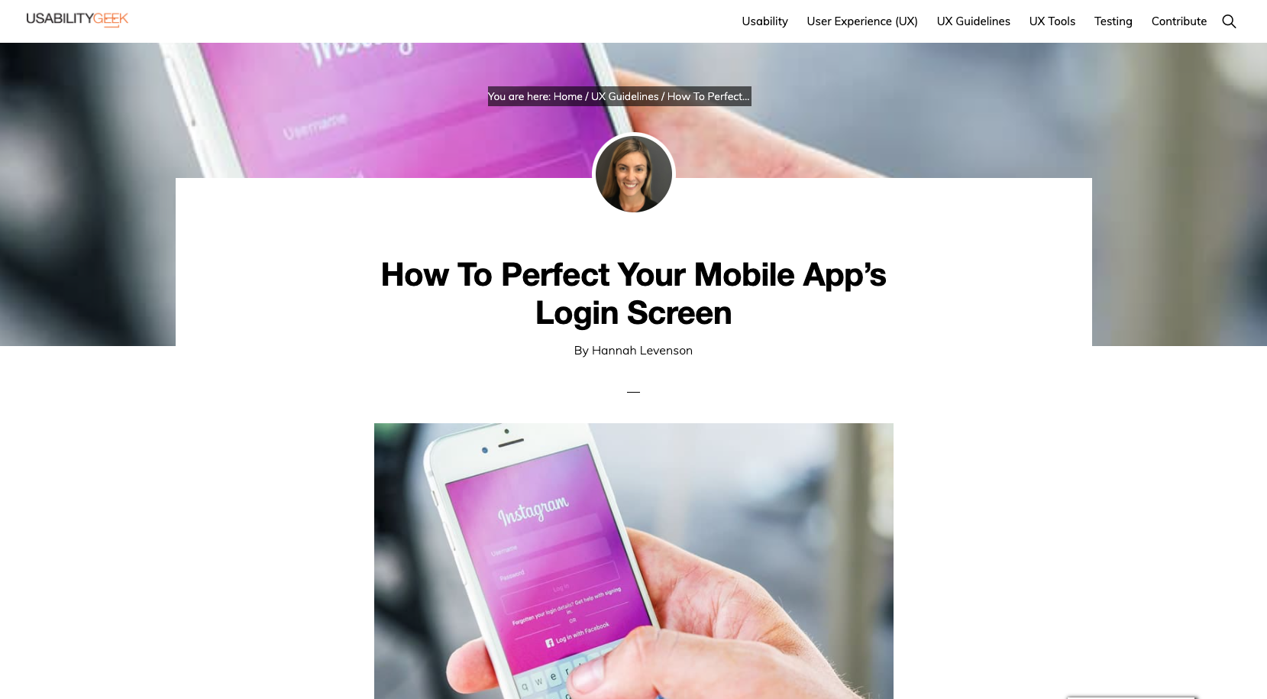
LEVENSON, H., 2017. How To Perfect Your Mobile App’s Login Screen - Usability Geek [viewed 25 October 2020]. Available from: https://usabilitygeek.com/perfect-mobile-app-login-screen/

Slide 8
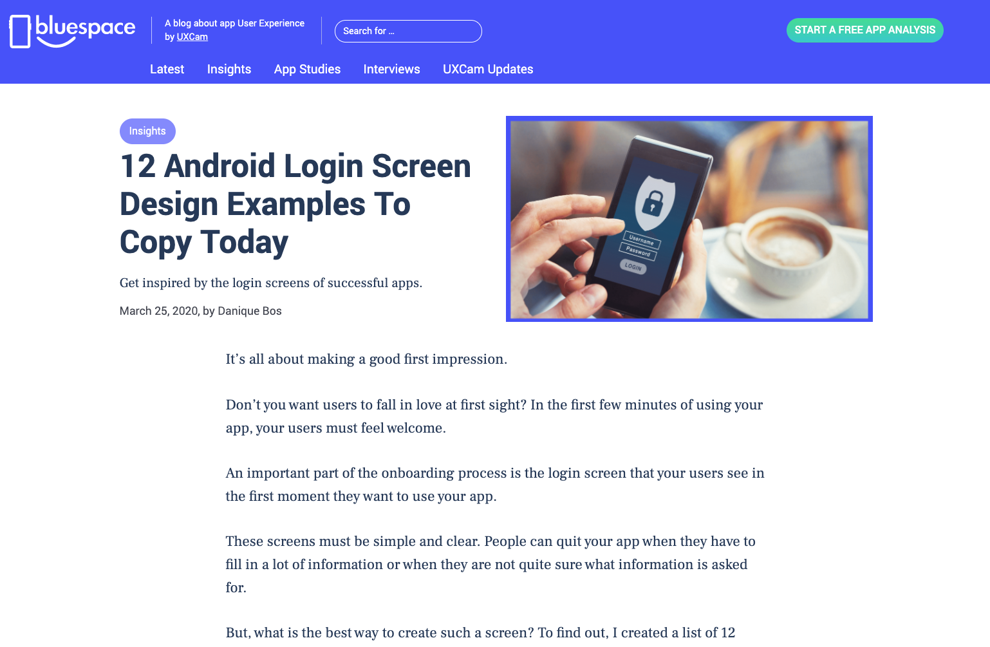
BOS.,D. 2020. 12 Android Login Screen Design Examples To Copy Today [viewed 25 October 2020]. Available from: https://uxcam.com/blog/login-screen-examples/

Slide 9
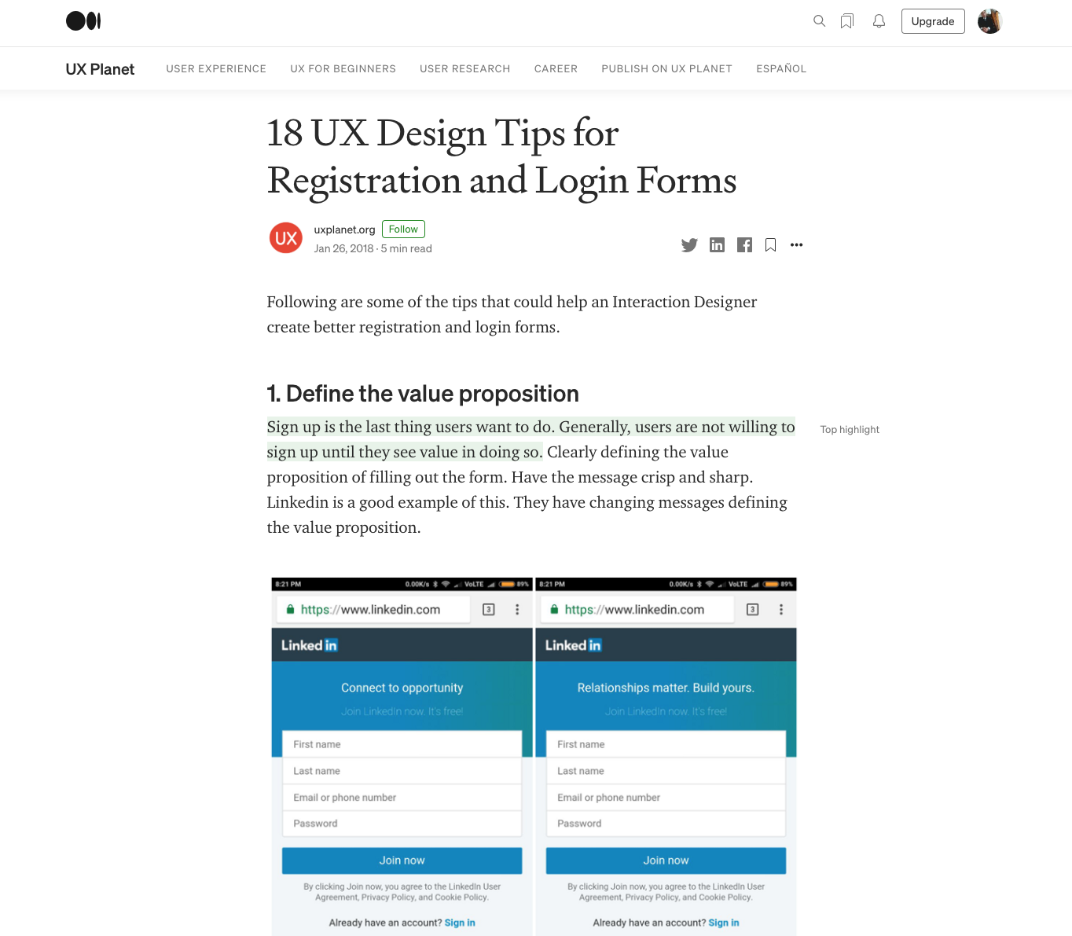
UXPLANET.ORG, 2018. 18 UX Design Tips for Registration and Login Forms - UX Planet [viewed 25 October 2020]. Available from: https://uxplanet.org/18-ux-design-tips-for-registration-and-login-forms-f897557358ba

Slide 10
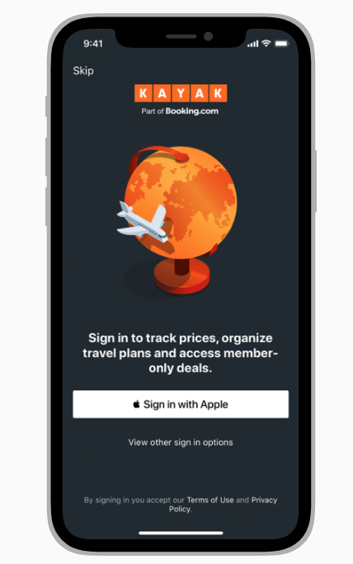
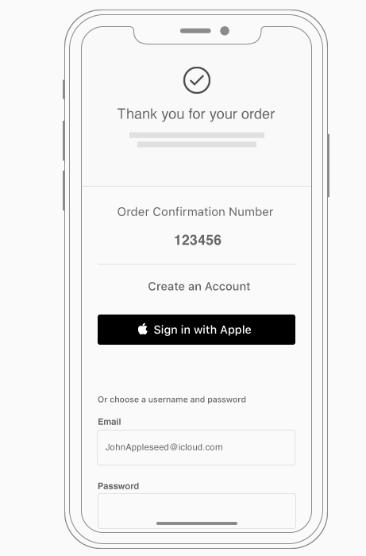
Apple Sign in
If your app requires signing into an account, display a brief, friendly explanation on the login screen that describes the reasons for the requirement and its benefits. Also, remember that not everyone using your app has an account from the start.
APPLE., 2020. Introduction - Sign in with Apple - Human Interface Guidelines - Apple Developer [viewed 25 October 2020]. Available from: https://developer.apple.com/design/human-interface-guidelines/sign-in-with-apple/overview/introduction/

Slide 11
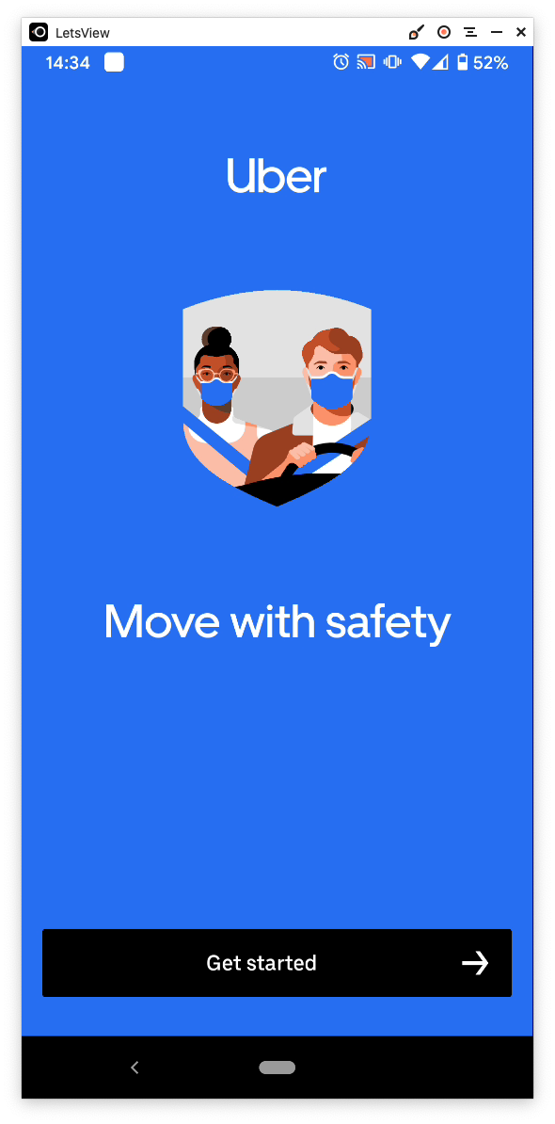
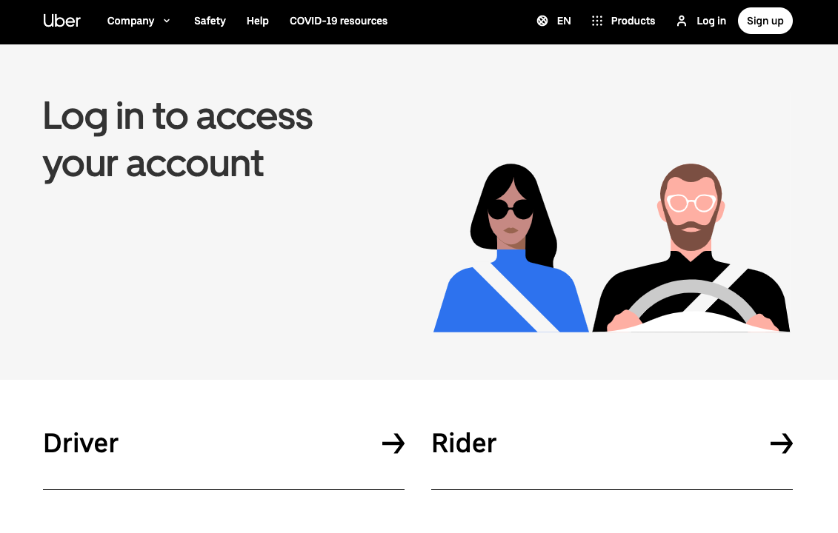
https://www.uber.com/global/en/sign-in/

Slide 12
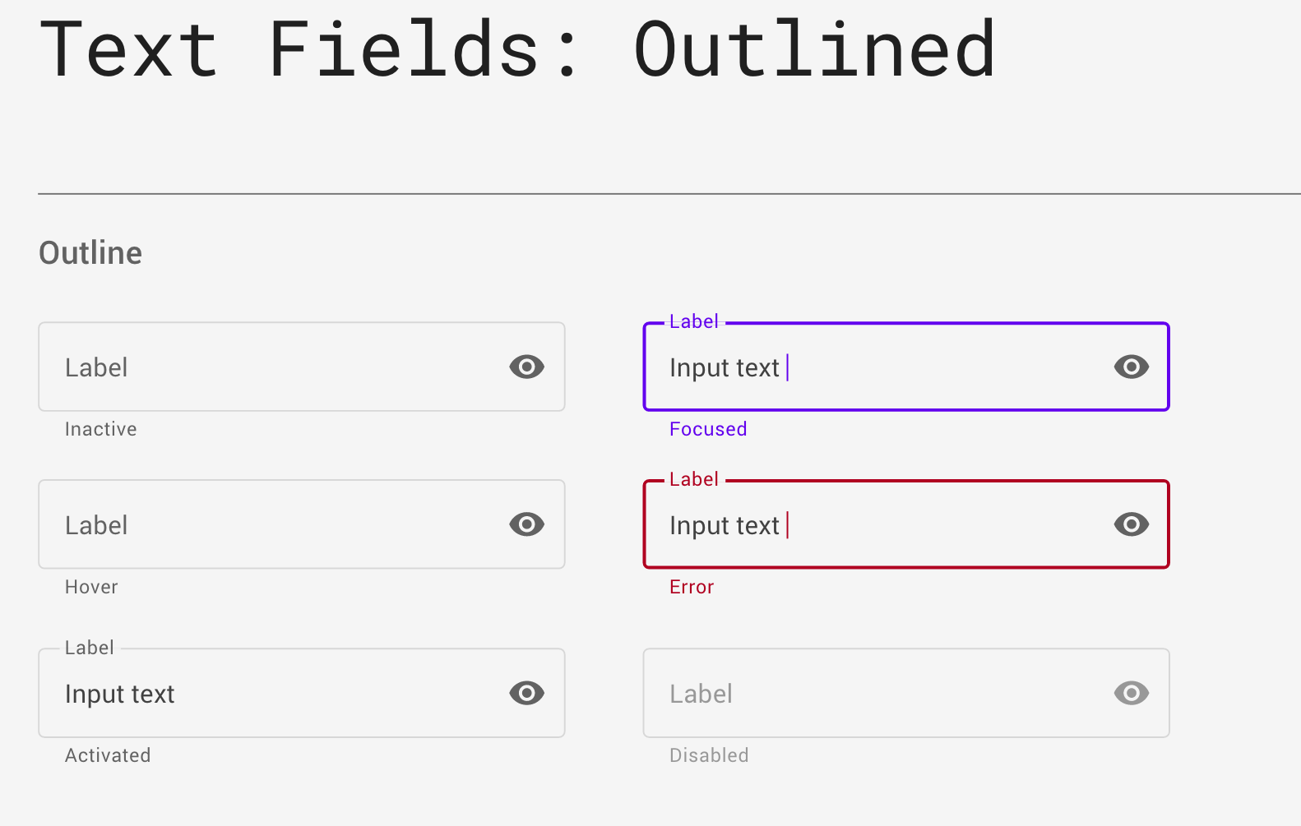

Slide 13
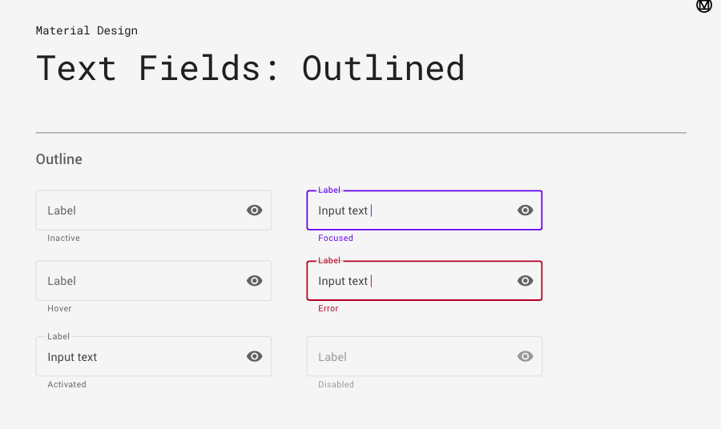

Slide 14
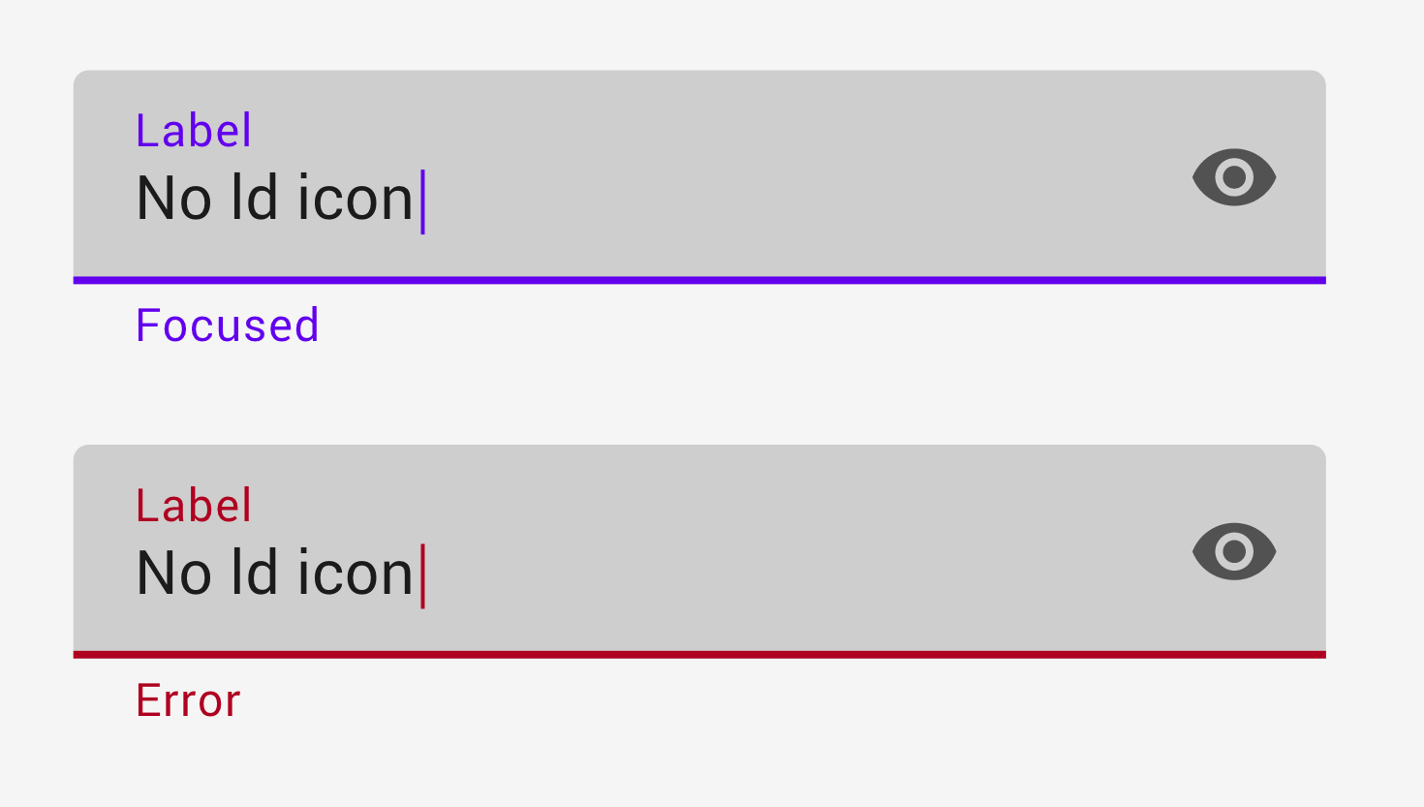

Slide 15
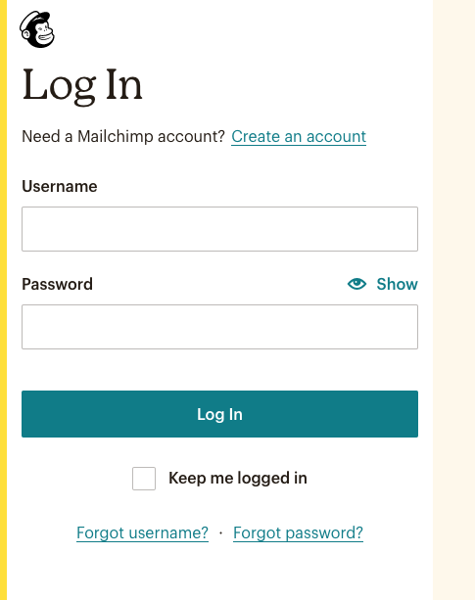
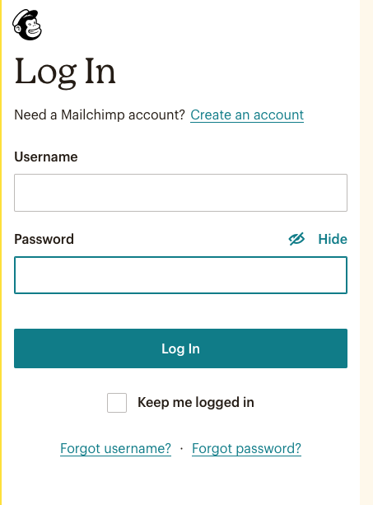

Slide 16
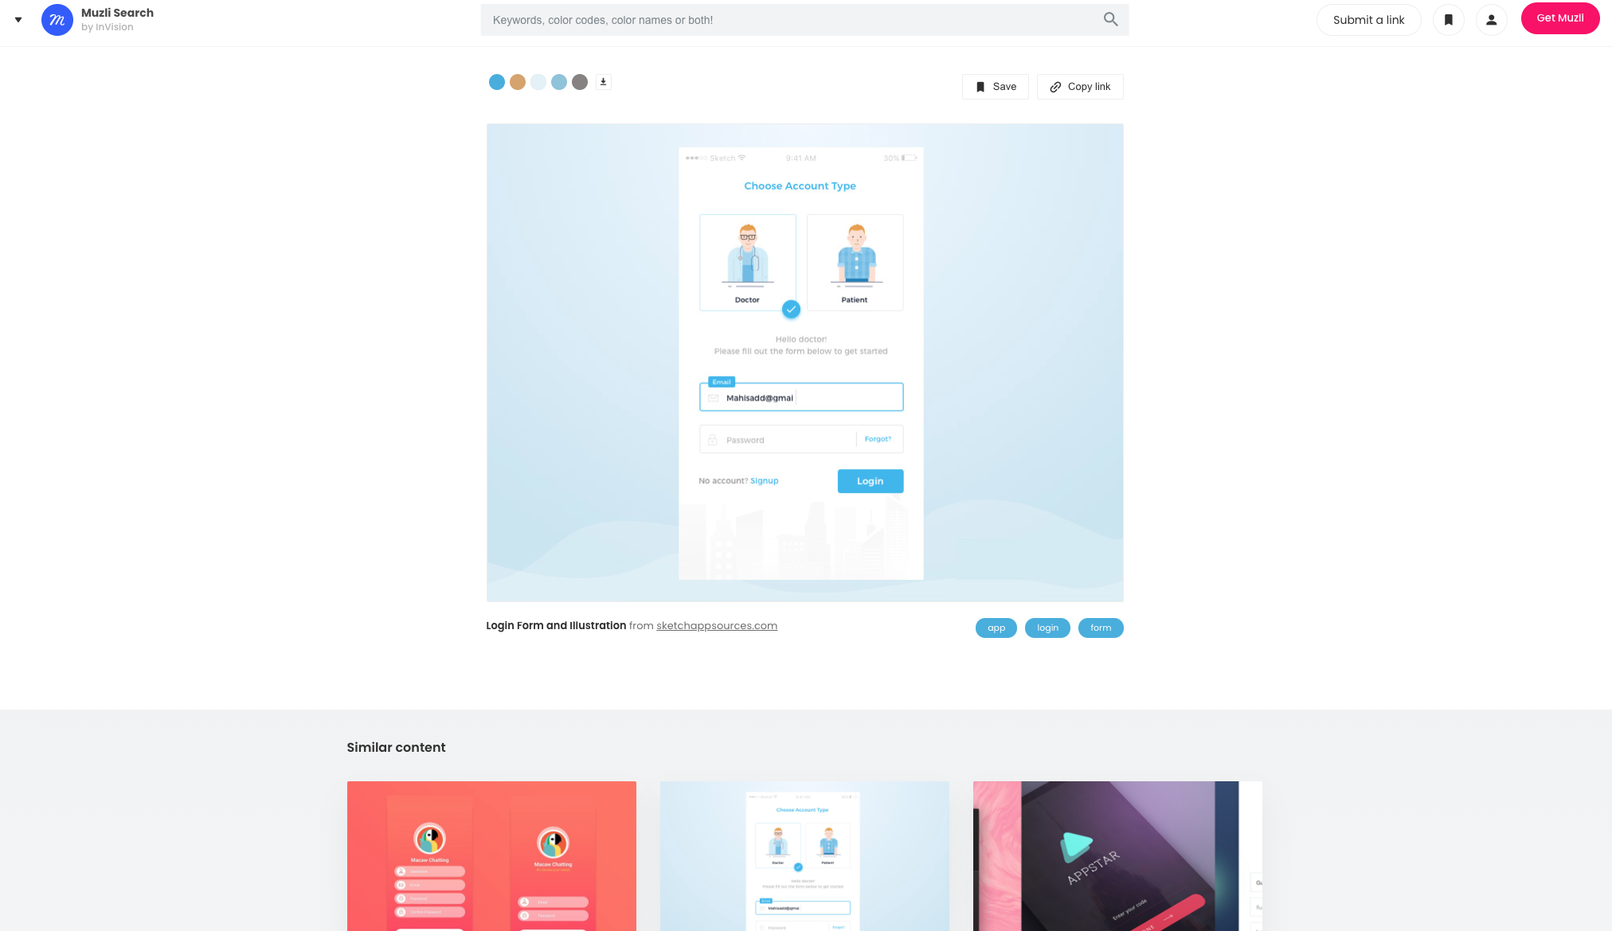
MUZILI., 2020. 439+ Login screens design inspiration, ideas and examples - Muzli Design Inspiration [viewed 25 October 2020]. Available from: https://search.muz.li/inspiration/login-screen/
‌

Slide 17
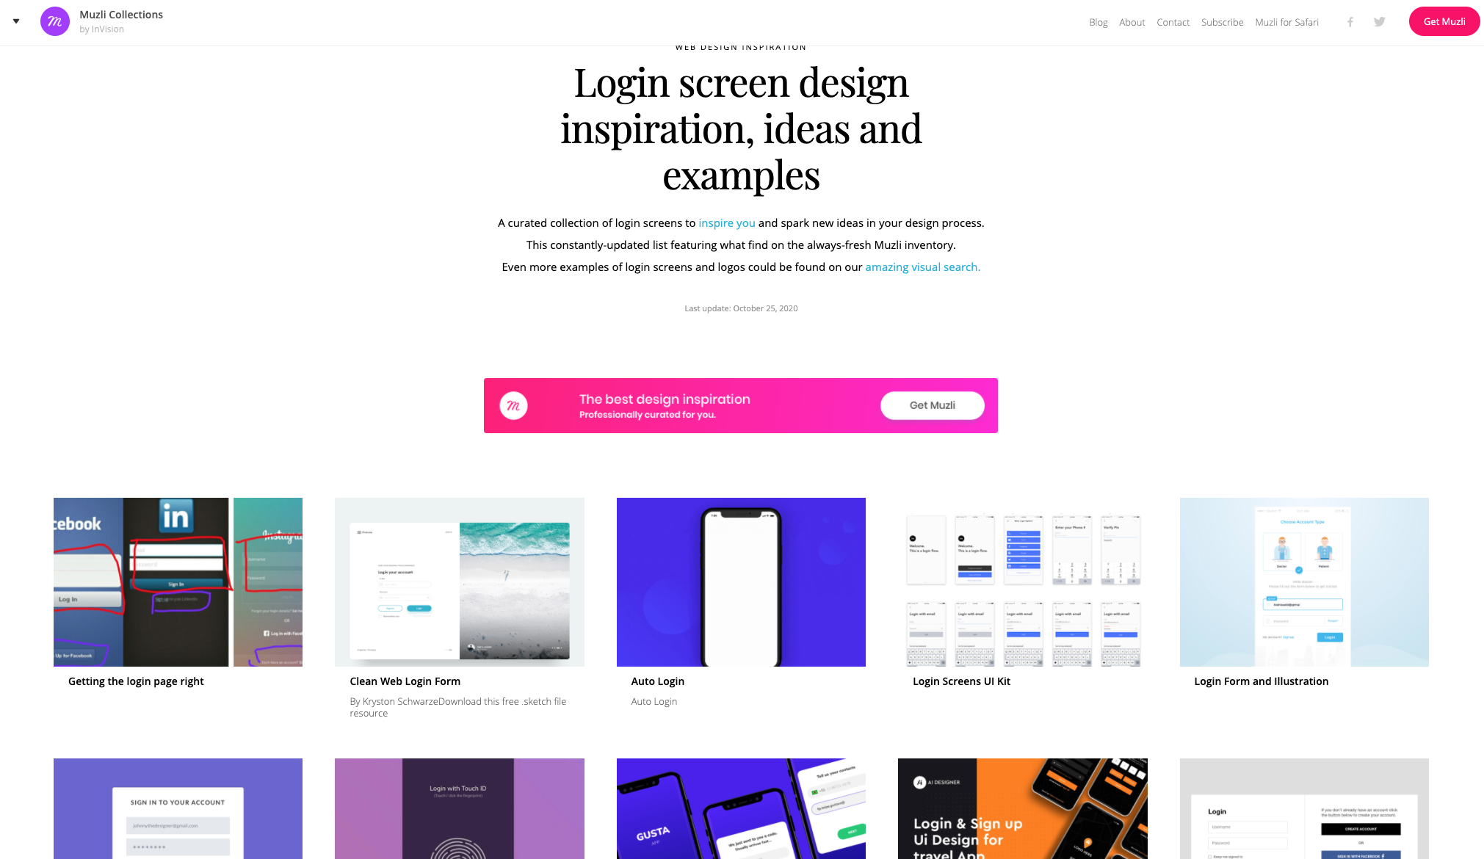
MUZILI., 2020. 439+ Login screens design inspiration, ideas and examples - Muzli Design Inspiration [viewed 25 October 2020]. Available from: https://search.muz.li/inspiration/login-screen/
‌

Slide 18
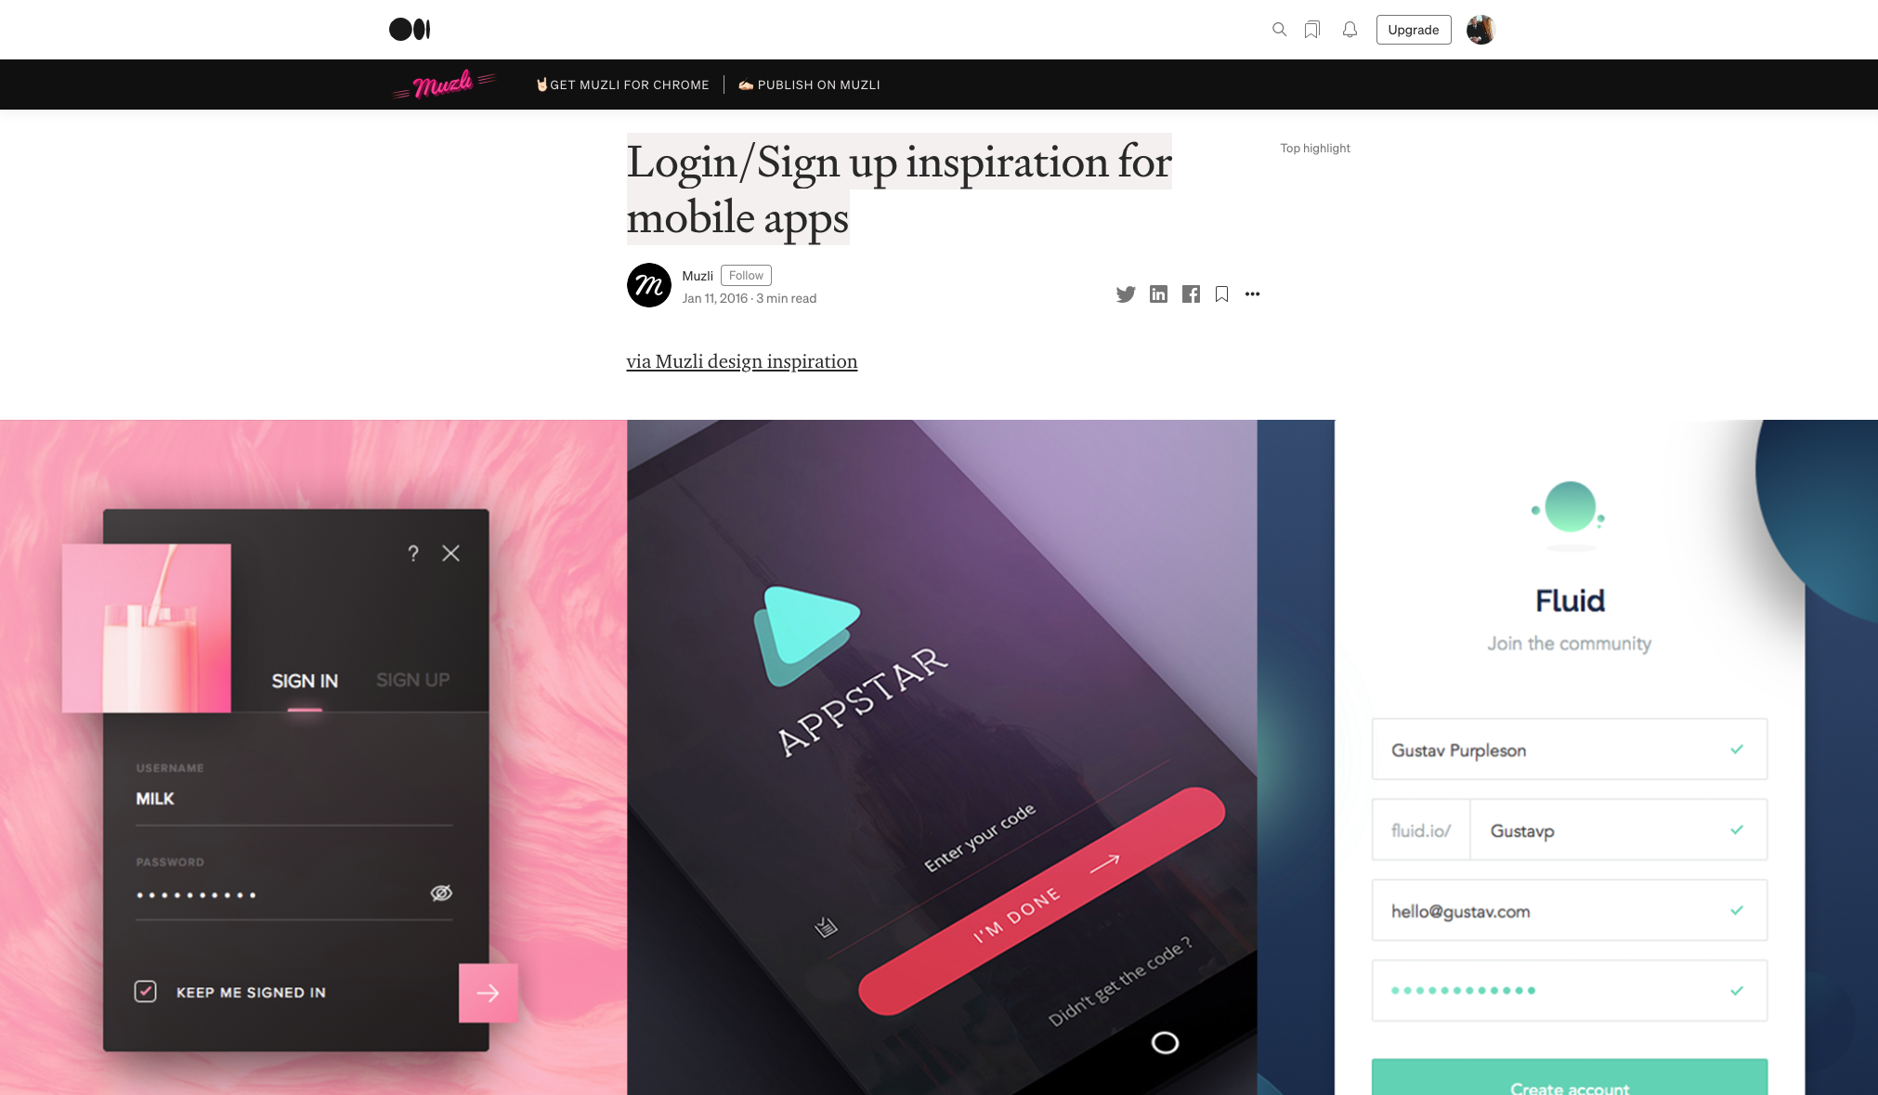
https://medium.muz.li/login-sign-up-inspiration-for-mobile-apps-aeff34090bbd

Slide 19
LOGIN SCREEN DESIGN TASK

Slide 20
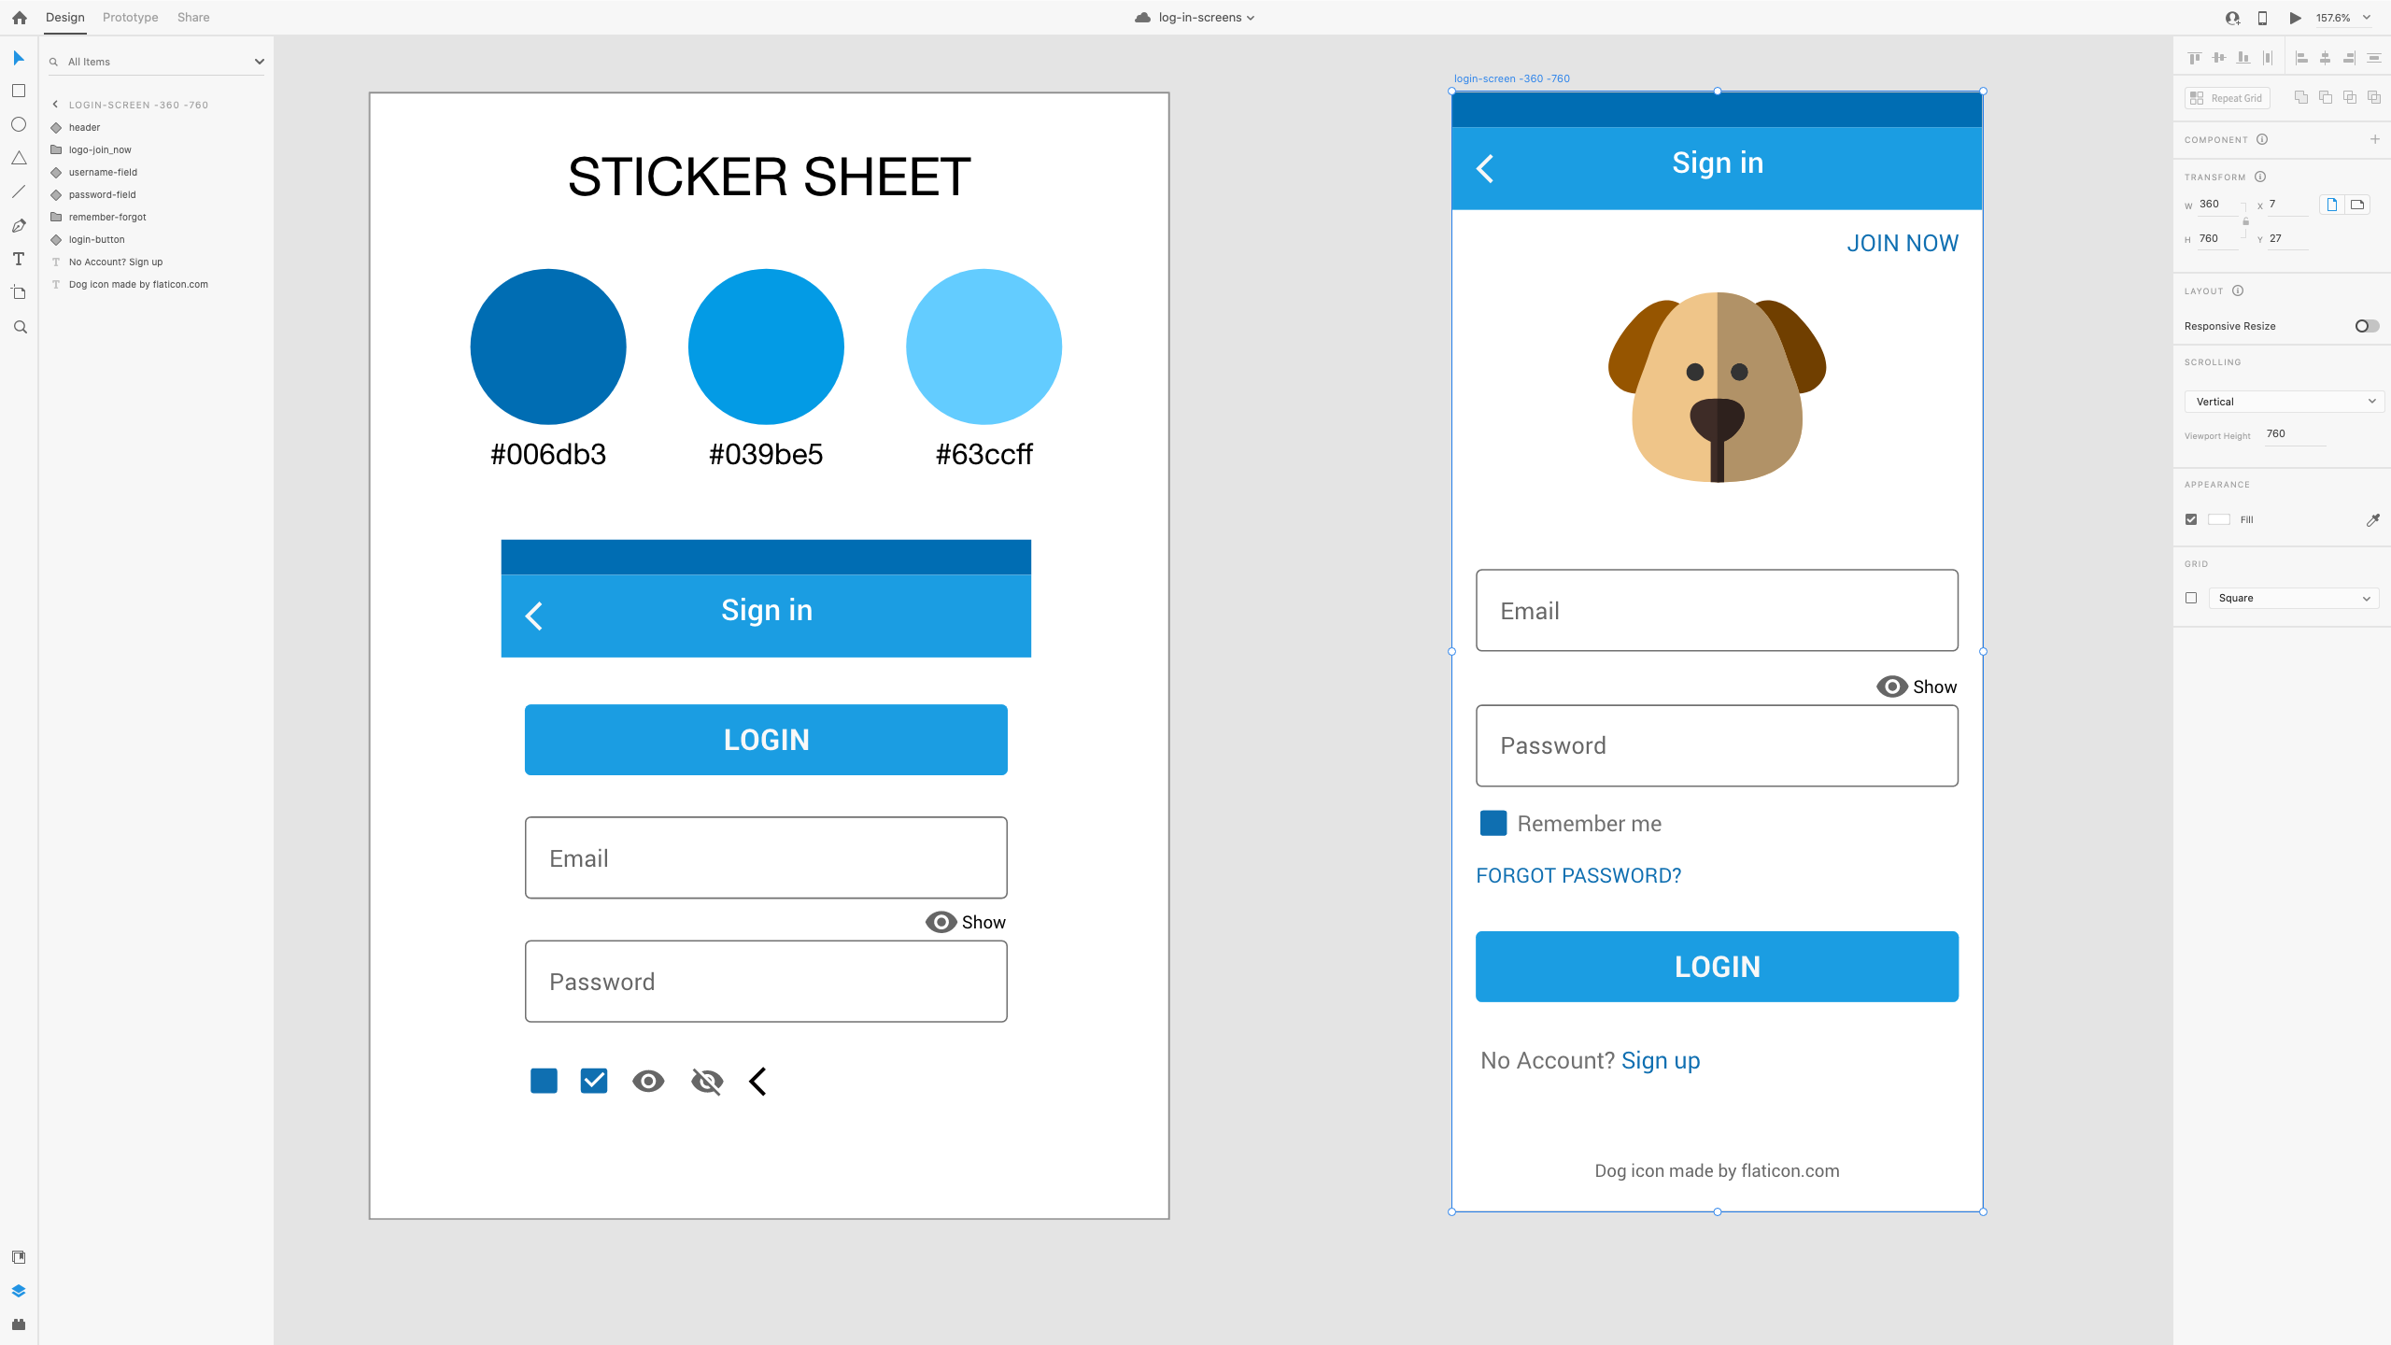

Slide 21
